Slide 1

Projectile Motion Part 1 Horizontal Projection

Slide 2
Break the Internet?
More Like FAKE the Internet!

Slide 3

Not again!
I should have payed more attention to projectile motion in Physics!
Lord Vader will force choke me for sure this time

Slide 4
Amazing facts!
If a gun is fired horizontally, and at the same time a bullet is dropped from the same height. Which will hit the ground first?

Slide 5
Amazing facts!

Slide 6
Amazing facts!

Slide 7
Amazing facts!

Slide 8
Amazing facts!

Slide 9
Amazing facts!
Why?

Slide 10

You don’t believe me do you!

Slide 11
Vertical and horizontal
Their vertical motion can be considered separate from their horizontal motion.

Slide 12
Vertical and horizontal
Vertically, they both have zero initial velocity and accelerate downwards at 9.8 m.s⁻². The time to fall the same vertical distance is therefore the same.

Slide 13

Watch that ball!
Imagine Kanye West has had an untimely death.
Luckily, he has donated his head to Science, where it will be used to demonstrate projectile motion.
My Teacher told me that
I’ve got a great head for Physics

Slide 14

Watch that ball!
The Kanye “ball” is kicked horizontally off the top of a cliff
v_{h}

Slide 15
Watch that ball!
Kanye’s head is kicked horizontally with an initial velocity v_{h}
v_{h}

Slide 16
Parabola
Assuming that there is negligible air resistance, he falls in the path of a parabola.

Slide 17
Parabola

Slide 18
Parabola
Why?

Slide 19
Why a parabola?
We can consider his motion to be the sum of his horizontal motion and vertical motion.
And better yet….
We can treat these separately
v_{h}

Slide 20
Horizontal motion
Assuming no air resistance, there are no horizontal forces.
Newton's first law must apply.
This means horizontally
the ball moves with
constant speed v_{h}
v_{h}
Horizontal distance travelled (s_{h}) = v_{h}t

Slide 21
Horizontal motion
If Kanye's head moves horizontally with constant speed v_{h,}
It must travel the same distance each second.
v_{h}
Horizontal distance travelled (s_{h}) = v_{h}t

Slide 22
Horizontal motion
If Kanye's head moves horizontally with constant speed v_{h,}
It must travel the same distance each second.
v_{h}
Horizontal distance travelled (s_{h}) = v_{h}t

Slide 23
Horizontal motion
If Kanye's head moves horizontally with constant speed v_{h,}
It must travel the same distance each second.
v_{h}
Horizontal distance travelled (s_{h}) = v_{h}t

Slide 24
Horizontal motion
If Kanye's head moves horizontally with constant speed v_{h,}
It must travel the same distance each second.
v_{h}
Horizontal distance travelled (s_{h}) = v_{h}t

Slide 25
Vertical motion
Assuming no air resistance, there is constant force downwards (=mg).
This means that if Kanye’s head is dropped vertically it will move downwards with constant acceleration, traveling an increasing distance each second.
g = 9.8 m.s⁻²
Vertical distance travelled (s_{v}) = u_{v}t + ½at²

Slide 26
Vertical motion
Assuming no air resistance, there is constant force downwards (=mg).
This means that if Kanye’s head is dropped vertically it will move downwards with constant acceleration, traveling an increasing distance each second.
g = 9.8 m.s⁻²
Vertical distance travelled (s_{v}) = u_{v}t + ½at²

Slide 27
Vertical motion
Assuming no air resistance, there is constant force downwards (=mg).
This means that if Kanye’s head is dropped vertically it will move downwards with constant acceleration, traveling an increasing distance each second.
g = 9.8 m.s⁻²
Vertical distance travelled (s_{v}) = u_{v}t + ½at²

Slide 28
Vertical motion
Assuming no air resistance, there is constant force downwards (=mg).
This means that if Kanye’s head is dropped vertically it will move downwards with constant acceleration, traveling an increasing distance each second.
g = 9.8 m.s⁻²
Vertical distance travelled (s_{v}) = u_{v}t + ½at²

Slide 29
Vertical motion
Assuming no air resistance, there is constant force downwards (=mg).
This means that if Kanye’s head is dropped vertically it will move downwards with constant acceleration, traveling an increasing distance each second.
g = 9.8 m.s⁻²
Vertical distance travelled (s_{v}) = u_{v}t + ½at²

Slide 30
Vertical motion
Assuming no air resistance, there is constant force downwards (=mg).
This means that if Kanye’s head is dropped vertically it will move downwards with constant acceleration, traveling an increasing distance each second.
g = 9.8 m.s⁻²
Vertical distance travelled (s_{v}) = u_{v}t + ½at²

Slide 31
Parabolic motion
Since y = ½ g t² (if u = 0) and x = v_{h}t, (t= x/v_{h})
y = ½ g x² / v_{h}²
This is a formulae for a parabola.

Slide 32

Example
Justin Bieber’s head is kicked off the top of a cliff with an initial horizontal velocity of 5 m.s⁻¹. If the cliff is 30 m high, how far from the cliff bottom will his head hit the ground?
5 m.s⁻¹
Time is the most important aspect of any projectile motion problem.
What component of the balls motion is most important in determining time in the air?
30 m

Slide 33
Example
u = 0
a = 9.8 m.s⁻²
s = 30 m
t = ?
Looking at vertical motion first:
s = ut + ½at²
30 = ½ x 9.8 x t²
t² = 6.1
t = 2.47 s
The head hits the ground after 2.47 seconds
5 m.s⁻¹
30 m

Slide 34
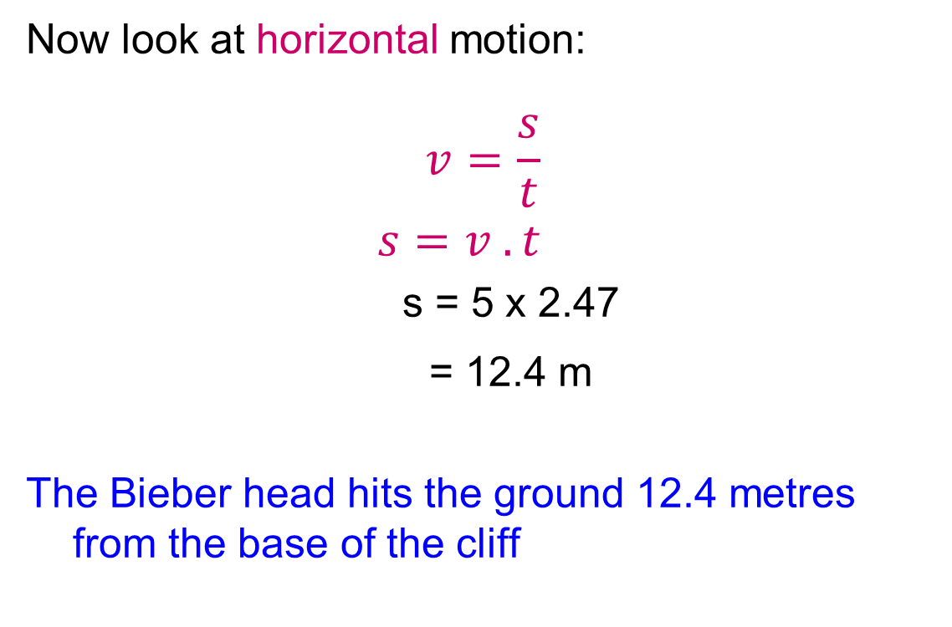
Example
v (horizontally) = 5 m.s⁻¹
t = 2.47 seconds
Now look at horizontal motion:
$$v=\frac{s}{t}$$
$$s=v . t$$
s = 5 x 2.47
= 12.4 m
The Bieber head hits the ground 12.4 metres from the base of the cliff
5 m.s⁻¹
30 m

Slide 35
Parabola
12.4 metres

Slide 36
What is the Bieber head’s speed as it hits the ground?
There are two ways to approach this problem.
Use your understanding of conservation of energy.
Calculate vertical velocity aspect and combine with horizontal aspect of motion.
5 m.s⁻¹
30 m

Slide 37
What is the Bieber head’s speed as it hits the ground?
Method 1. To answer this it is sometimes easier to think in terms of the head’s total mechanical energy (kinetic and potential)
5 m.s⁻¹
30 m

Slide 38
What is the Bieber head’s speed as it hits the ground?
Total mechanical energy at top = ½mv² + mgh
Total energy = ½m(5)² + mx9.8x30
Total energy = 12.5m + 294m = 306.5m
5 m.s⁻¹
30 m

Slide 39
What is the Bieber head’s speed as it hits the ground?
At the bottom, all the potential energy has been converted to kinetic energy. All the ball’s energy is now kinetic.
energy = ½ mv²
V = ?

Slide 40
What is the Bieber head’s speed as it hits the ground?
mechanical energy at top = mechanical energy at bottom
306.5m = ½mv²
306.5 = ½v²
613 = v²
v = 24.8 m.s⁻¹
(Note that this is the head’s
speed as it hits the ground,
not its velocity.
Speed = 24.8 m.s⁻¹

Slide 41


What is the Bieber head’s speed as it hits the ground?
Method 2. Calculate final vertical component of velocity.
5 m.s⁻¹
$$v^{2}=u^{2}+2as$$
$$v^{2}=0^{2}+2x 9.80 x 30$$
$$v^{2}=588$$
$$v=24.25 ms^{−1} down$$
$$u=0ms^{−1}$$
$$s=30m down$$
$$g=9.88 ms^{−2} down$$
30 m

Slide 42



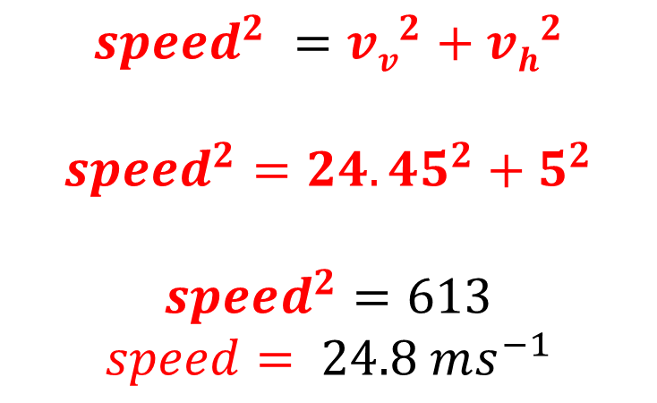
What is the Bieber head’s speed as it hits the ground?
$$vv$$
$$24.25 ms^{−1}$$
$$down$$
Method 2. Add to horizontal component of velocity.
$$speed$$
5 m.s⁻¹
$$vh=5 ms^{−1} right$$
$$speed^{2} =vv^{2}+vh^{2}$$
$$speed^{2}=24.45^{2}+5^{2}$$
$$speed^{2}=613$$
$$speed= 24.8 ms^{−1}$$
30 m

Slide 43
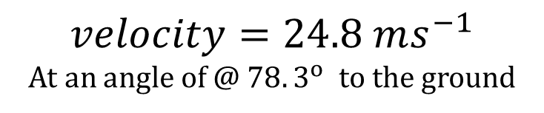


What is the Bieber head’s VELOCITY as it hits the ground?
$$vv$$
$$24.25 ms^{−1}$$
$$down$$
Is speed the same as velocity?
No – Velocity needs a direction.
$$velocity=24.8 ms^{−1}$$
5 m.s⁻¹
$$vh=5 ms^{−1} right$$
$$tan θ=\frac{opp}{hyp}$$
$$tan θ=\frac{24.25}{5}$$
$$θ=78.3^{o}$$
$$velocity=24.8 ms^{−1}$$
At an angle of @ $78.3^{o}$ to the ground
30 m

Slide 44


